Slide 1
ACID
ANALYZING CENSUS AND IMAGING DATA
STAT 157: TEAM 18: ALEX KASSIL, CATHERINE CANG, INNA CHERNOMORETS, DEREK TOPPER

Slide 2
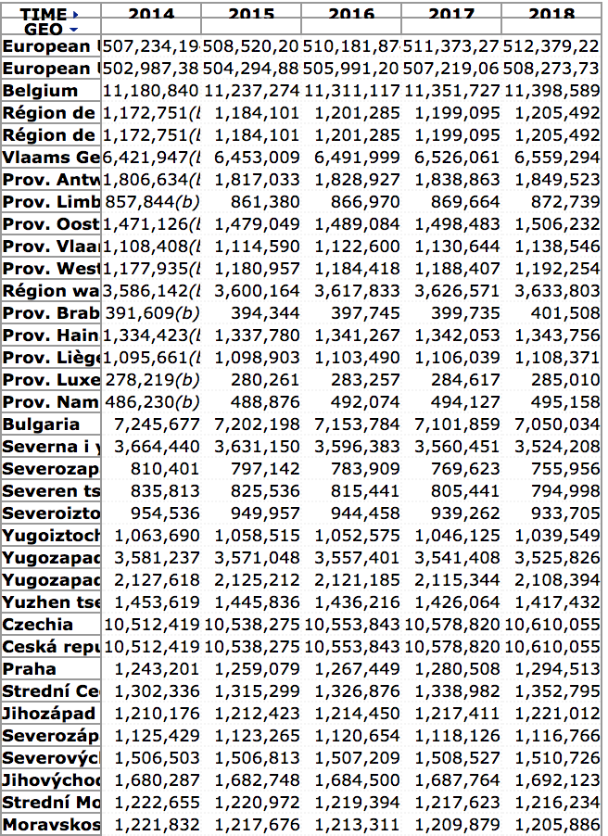
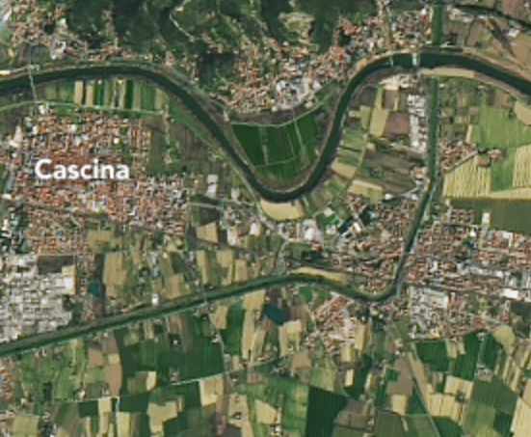
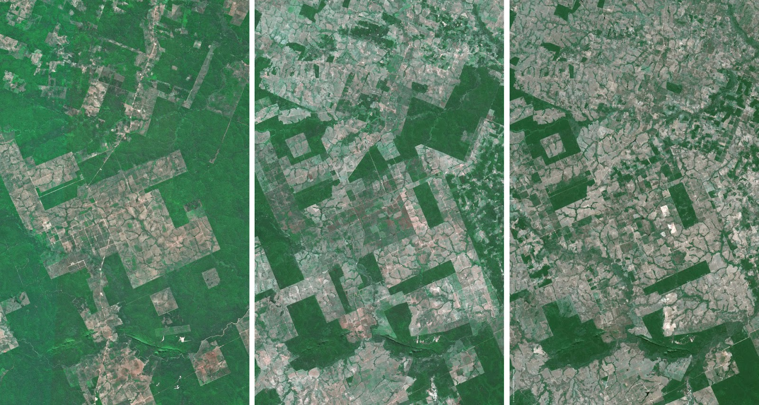
PROBLEM AND SOLUTION
There are not enough manual resources for countries to monitor their population growth.
But due to vast improvements in satellite technology, there are now daily photos of the entire Earth’s surface. We want to use this wealth of spatial and temporal data
Therefore, we have used open-source satellite imagery from Landsat 8 and census data from Eurostat to create population predictions for the European continent.
Our project: Using satellite images and CNNs to predict population density
Example of Landsat 7 data (Cascina, Italy)
Satellite images from various sites
European census data from 2014-18

Slide 3
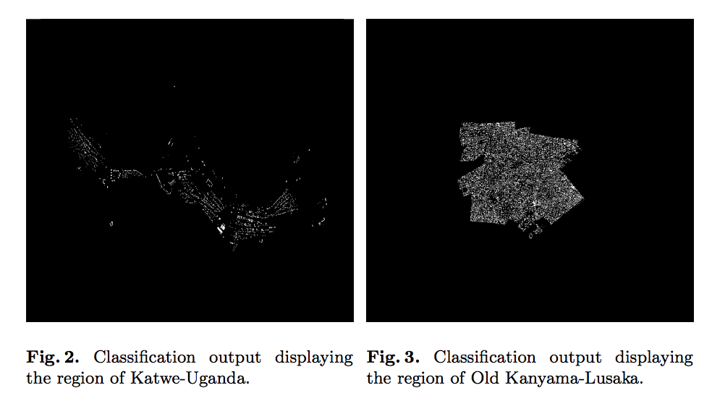
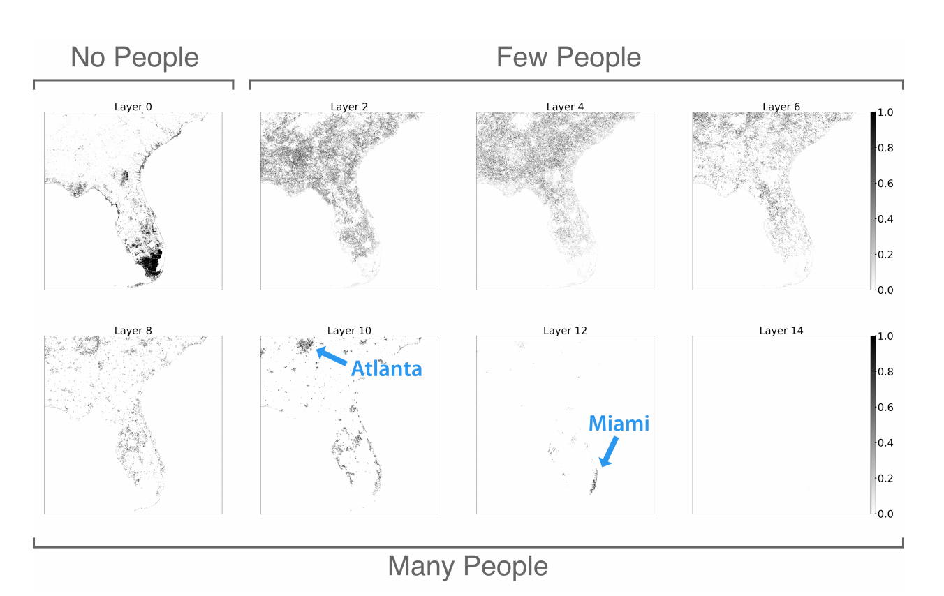
PAST RESEARCH
Past research has been done using American and Ugandan population predictions
Regional Population Estimation Using Satellite Imagery
A Deep Learning Approach for Population Estimation from Satellite Imagery
Our modifications:
Increased number of past data generated from our satellite to population model
Comparisons between improved neural network models, including regression
Large-scale predictions - more accessible than close-up high-res images

Slide 4
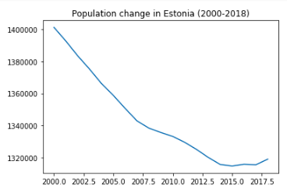
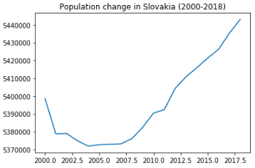
MODELS
Classification - Trained on 1384 values
ResNet 50 Base
10 classes for log population density 0-10
Regression - Trained on 2048 values
ResNet 18 Base
Output log population density as a scalar value
Removed Average Pooling layer for Flatten layer
Regression w/ Augmentation
Same as Model #2, but with Data augmentation
Rotations, Shifts, added gaussian noise
Notes:
Failed attempts
resnet 50 with raw population data
^ w/ data augmentation
stride layers with larger images (889x889x3) with one/ two stride layers before feeding it in
both did worse; bottleneck = low data amounts

Slide 5
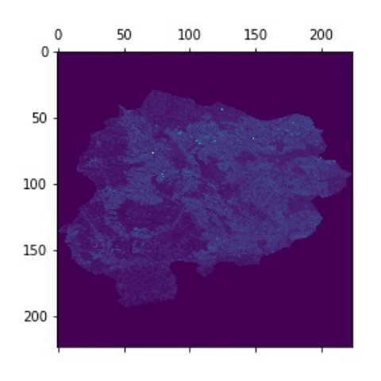
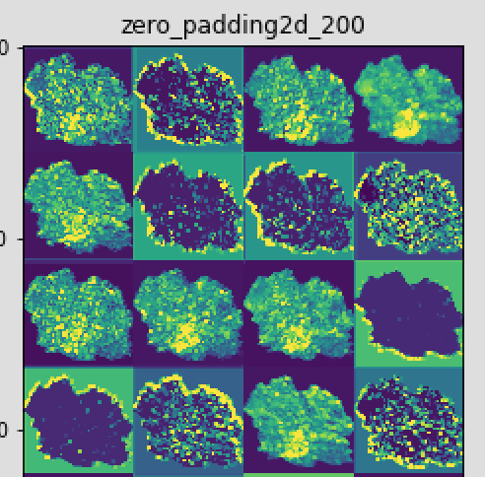
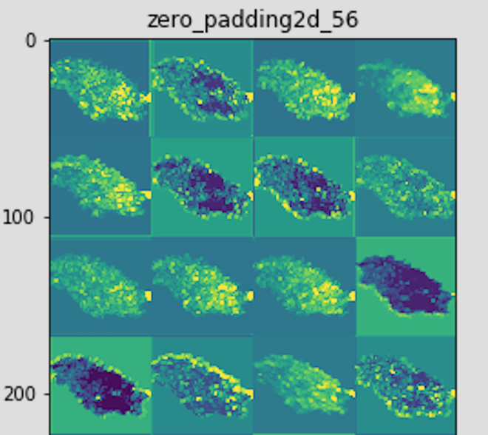
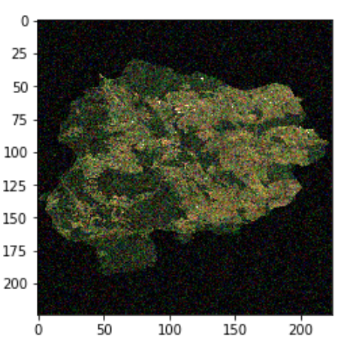
MODEL - VISUALIZATIONS
We adapted ResNet 50 and ResNet 18. Shown are intermediate layer activations.
Notes:
Left is without noise, right is model with noise. Left model performed better, but the one on the right places less emphasis on the edges. Future: add more noise.
Rightmost: Noisy image

Slide 6
WORKFLOW
First, we converted the satellite images into a resized RGB image for easier use.
Also tried using high stride with higher quality images to downsample
Wrote python scripts to download thousands of .tif images (dozens of gigabytes total)
We then used Keras to build both models with roughly 25 million parameters.
Then, using CNNs with input (?, 224, 224, 3), we made 3 models
Trained with 2048 images, verified on 683 images
Applications: We used a sliding box to generate heatmaps of the populations in squares of different regions
Results:
Regression: With data augmentation: 1.4702 MSE
Regression: Without data augmentation: 2.0414 MSE
Classification with 10 classes: 99.94% training accuracy, 74.14% test accuracy
Notes:
on the note of higher quality images -- took too much memory/time

Slide 7
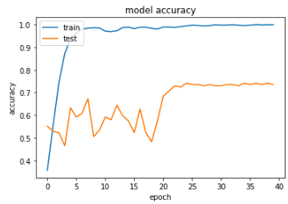
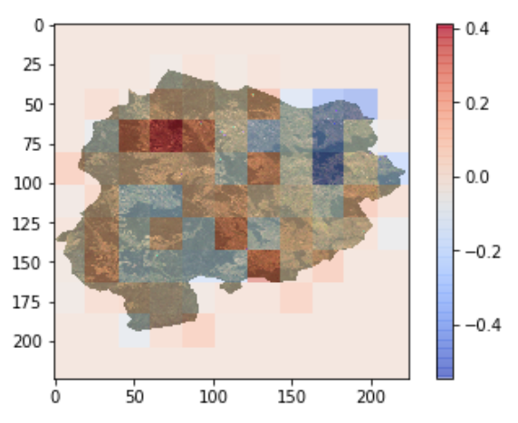
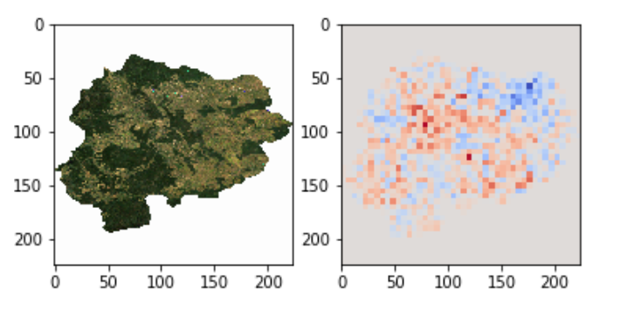
RESULTS - VISUALIZATIONS
Heatmaps generated
Loss plots for classification

